Slide 1

NBEAC Training
Understanding and Preparing for Accreditation
24-25 July, 2017
Dr. Sadia Nadeem, FAST School of Management, NUCES, Islamabad | Dr. Asfia Obaid, NUST Business School, NUST, Islamabad

Slide 2
Reasons for Gathering: Learning Outcomes
Develop an in-depth understanding of the accreditation process
Improve the ability to complete the registration application
Enhance knowledge of documents required for completing the SAR
Improve the ability to complete the SAR
Refine the capability to arrange a Peer Review Visit
Notes:
The training is not going to cover re-accreditation and CIR details directly.

Slide 3
Two Day Agenda
Day 1
Session 1 | 9:00 am -10.30 am | Introduction, philosophy of accreditation and review / discussion of selected appendices
 | 10.30 am -11:00 am | Tea Break
Session 2 | 11:00 am – 1:00 pm | Discussion of Registration form and process
 | 1:00 pm -2.30 pm | Lunch Break
Session 3 | 2.30 pm – 5:00 pm | Discussion on SAR forms (1-3)
Day 2
Session 4 | 9:00 am -11:00 am | Discussion on SAR forms (5-7)
 | 11:00 am -11:30 am | Tea Break
Session 5 | 11.30 am -12.30 pm | Discussion on SAR forms (8-9)
 | 12.30 pm - 1.30 pm | Lunch Break
Session 6 | 1.30 pm - 3.15 pm | Discussion on preparation and conduct of PRT
 | 3.15 pm - | Closing Ceremony

Slide 4


Session 1
9:00 am -10.30 am
Introduction, philosophy of accreditation and review
 | NATIONAL BUSINESS EDUCATION ACCREDITATION COUNCIL www.nbeac.org.pk

Slide 5
Introductions

Slide 6
NBEAC Overview
Established in 2007 by HEC
2007 -2009: Designing and planning
Enhancing Business Education in Pakistan
  Accreditation of business schools/DMS
  Development of business schools/DMS
Started accreditation process in 2010
  Three day visit by a team of five (including an industry representative)

Slide 7
Nine Areas of Accreditation
Strategic Management
Curriculum
Students
Faculty
Research and Development
Social Responsibility
Resources
Student Placement and External Linkages
Admission and Examination Policy

Slide 8
The D&D Conferences
Executives and senior faculty from around 100 plus business schools from across Pakistan get together for strategic level discussions
2nd – 3rd Week of February
  2014: Islamabad
  2015: Karachi
  2016: Lahore
  2017: Islamabad
In the 4th D&D Conference, 167/180 campuses of business schools from across Pakistan were represented
In the 3rd D&D Conference, 124/160 campuses of business schools from across Pakistan were represented
Breaking silos
Learning from each other
Supporting each other

Slide 9
What is Accreditation?
Accreditation is the process in which certification of competency, authority, or credibility is presented.
Educational accreditation is a type of quality assurance process under which services and operations of educational institutions or programs are evaluated by an external body to determine if applicable standards are met. If standards are met, accredited status is granted by the appropriate agency. (Google)
Accreditation is a process of recognizing educational institutions for performance, integrity, and quality that entitles them to the confidence of the educational community and the public. (EFMD/NBEAC)

Slide 10
A Few Questions
How many of you have administrative responsibilities? (at present or in the past)
How many of you have academic responsibilities? (at present or in the past)
Have you received training for enhancing administrative or academic abilities?
  Length of training?
  Frequency of training?
  On-the-job or off-the-job?

Slide 11
A Few More Questions
How many of you have been a focal person in a peer review visit? (excluding any future planned ones)
Are any of you a part of the peer review panel?
Have any of you visited another school as a part of a peer review team?

Slide 12
NBEAC Accreditation
Enhancing Business Education
Quality assurance
Learning and supporting each other

Slide 13
Discussion of Selected Appendices
School’s organogram, vision and mission, strategic plan
Template for course outline
Academic dishonesty and plagiarism policy
Policy and process of scholarships disbursement
Structure and by-laws alumni association/chapter/cell in the business school
Calendar of extra-curricular, co-curricular, social responsibility activities, placement office
Policy for faculty selection, retention, promotion, training, appraisals, international exposure, delivering trainings and doing consultancy work
R&D policy and record
List of MoUs for linkages and social responsibility
Notes:
We can do group discussion on this slide.

Slide 14
Session 2
11:00 am – 1:00 pm
Discussion of Registration Form and Process
 | NATIONAL BUSINESS EDUCATION ACCREDITATION COUNCIL www.nbeac.org.pk

Slide 15
Process Flow for Accreditation
1. Formal Application Received by NBEAC Secretariat
2. Pre-Eligibility Mentorship -Selection of Advisor After Mutual Consensus of Business School and Secretariat (Optional Visit)
3. Eligibility Screening (by Eligibility Screening
Committee (ESC)
5. Self Assessment Process (Preparation of SAR)
6. Peer Review Process
4. Pre-Review Mentoring
7. Accreditation Decision(Acceptance/Rejection by Accreditation Award Committee) for a period
8. Continuous review (Re-accreditation or Revisit)

Slide 16
Stage 1: Registration (Data Sheet)
Sections 1-3: School /University Information (contact, general and governance)
Section 4: Degree program Information (eligibility, curriculum and awarding criteria
Section 5: Student Information (enrollment and demographics)
Section 6: Faculty & Staff Information (statistics, demographics, workload and ratios) Table 1 and 2
Section 7: Research Information (papers, conferences and others) Table 3
Section 8: Facilities Information (Rooms, library, labs, centers etc.)
Section 9: Ethics, Community Service and Social Responsibility

Slide 17
Stage 1: Supporting Documents Required
Cross cheque/ Bank draft/ Pay order of Rs. 25000
Copy of Charter
Copy of approved strategic plan
Documentary Evidence of approved vision and mission statement of business school
Curriculum Vitae of Dean, HoD and Focal Person
Curriculum Vitae of Placement Officer

Slide 18
Stage 2: Pre-Eligibility Mentorship
Purpose - To address the developmental needs identified during the eligibility screening process to produce an updated Datasheet.
Visit – During the ONE day visit, mentor interacts with the School's Director/Dean, the internal committee and the faculty and informs the minimum criteria for accreditation.
Post Visit – Mentor submits report and specifies time required for submission.
*Note: Involvement and support of mentor is a voluntary activity initiated at the request of the school.

Slide 19
Stage 3: Eligibility Screening (Criteria)
At least 3 batches of the degree should have passed to consider the program for accreditation.
Vision & Mission
Strategic Plan
Faculty – Portfolio, Diversity, International Exposure, Full time: Part time ratio
Student : Teacher Ratio
Student : Computer Ratio
Course Load

Slide 20
Stage 4: Pre-Review Mentorship
Purpose - To cross check the data given in the forms and presented by the school, to identify the gaps and suggest improvements essential before submission of Self Assessment Report (SAR).
Visit – During the ONE day visit, mentor interacts with the School's Director/Dean, the internal committee and the faculty to understand the process followed and issues / concerns of the school.
Post Visit – Mentor submits report, specifies time required for submission and recommends conduct of Peer Review Visit.
*Note:
Involvement and support of mentor is a voluntary activity initiated at the request of the school.
The visiting team is composed of 01-02 members. The mentor would not be in the PRP or business school team which prepares the SAR and chalks out steps for peer review and accreditation.

Slide 21
Session 3
2.30 pm – 5:00 pm
Discussion on SAR forms (1-3)
 | NATIONAL BUSINESS EDUCATION ACCREDITATION COUNCIL www.nbeac.org.pk

Slide 22
Proforma 1: Strategic Management
Vision and Mission
The School should have a clearly articulated vision and mission that is understood and shared throughout the institution.
Governance
The School should have an effective and integrated organisation for the management of its activities based on appropriate processes, with a significant degree of control over its own destiny.
Strategy
The School should have a defined, credible and coherent strategy, realistically reflecting its market positioning, resources and constraints.

Slide 23
Accreditation Criteria
Autonomy of the Business School
Financial Support
External Participation in Academic Governance
Internal Governance
Sense of Vision and Mission
Credibility of Strategic Planning and Positioning
Notes:
(This is a C/P from the rubric. SANIA will have these lists in X category document)

Slide 24
Main Points Covered in P1
Vision and Mission
Strategic Plan – Planning and implementation
Budget presentation – Options & Alternatives
Governance – Engagement of Stakeholders and Autonomy
Structure and Processes
Academic Head – Requirements

Slide 25
Appendices for P1
Name | Description
Appendix-1A | CV of the dean, HoD and focal person
Appendix-1B | Copy of the charter
Appendix-1C | Parent institution’s organogram
Appendix-1D | School’s organogram
Appendix-1E | Composition, role and functions of statutory bodies
Appendix-1F | Approval of the business schools’ vision and mission
Appendix-1G | Complete strategic plan of the business school
Appendix-1H | Approval of the business schools’ strategic plan
Appendix-1I | Byelaws/SoPs of the business school

Slide 26
Supporting Documents for P1
Minutes of last three meetings of Governing bodies (Deans Committee, Board of Faculty, Board of Studies, Board of Advanced Studies and Research, Academic Council, Board of Governors, Executive Council)
Minutes of faculty departmental meetings of last two months(if any)
Last strategic plan(if any)
Auditors report (last three years)
Approved budget of the university and/or of the school for the last three years

Slide 27
Expected Standards in Strategic Management
Discussion on standard document

Slide 28
Proforma 2: Curriculum
A well designed curriculum should be approved by the university’s statutory bodies and should meet the structural requirements of national regulatory bodies. Program should be well designed with clear learning outcomes and an appropriate balance between knowledge acquisition and skills acquisition in the program and all courses within the program. Delivery methods should be diverse and reflect up-to-date educational practice. The curriculum should emphasize student learning, allow for practical work and soft skills provision, and should include relevant local material. There should be rigorous assessment processes for monitoring the quality of students’ learning.

Slide 29
Accreditation Criteria
Curriculum and Portfolio Alignment
Program Design
Content and Coverage
Responsiveness to Corporate Needs
Indigenous and Comparative Material in Course Content
Soft Skills Provision
Program Delivery
Examination and Assessment
Academic Honesty

Slide 30
Main Points Covered in P2
HEC Roadmap – the stories
Learning outcomes and objectives of the program and their alignment with vision/mission
Template for course outline and samples – the stories
Processes to ensure quality of course design and delivery, including assessment
Focus on technical knowledge and soft skills
Exam and result monitoring
Academic dishonesty

Slide 31
Appendices for P2
Name | Description
Appendix-2A | Standard template for course outline
Appendix-2B | Course outlines of 2 to 3 core, 2 to 3 electives and 2 to 3 general courses
Appendix-2C | Timetable of current and previous semester
Appendix-2D | Policy to conduct, review, monitor, evaluate and/or moderate the question papers and quality of examination results
Appendix-2E | Policy to monitor the quality of exam results
Appendix-2F | Academic dishonesty policy
Appendix-2G | Plagiarism policy

Slide 32
Supporting Document for P2
Minutes of last three meetings of statutory bodies (Deans Committee, Board of Faculty, Board of Studies, Academic Council, Board of Governors, Executive Council)
Course folders of all courses of the program under review for last two years for fulltime as well as visiting faculty
QEC audit report of the program(s) under accreditation.
A copy of the current semesters’ timetable.
Evidence of monitoring and evaluation of the question papers and exam results.
Record of any academic dishonesty cases

Slide 33
The Course Folder
A copy of the course outline
A copy of the attendance record
A record of weekly teaching which can be in handout of slides format if slides are used, or a half to one page summary of the areas covered in class
The record of all assignments, tests, quizzes, projects which contribute to the semester marks
A copy of the three best and three worst assignments, tests, quizzes and projects (three average)
The question papers of sessional/mid-term and final;
A copy of the three best and the three worst papers of sessional/mid-term and final
Concluding comments by the instructor
A signed copy of the detailed excel sheet with final grades

Slide 34
Course Folder Contd…
Helps understand
Program Design
Content and Coverage
Responsiveness to Corporate Needs
Indigenous and Comparative Material in Course Content
Soft Skills Provision
Program Delivery
Examination and Assessment
Academic Honesty

Slide 35
Expected Standards in Curriculum
Discussion on standards document

Slide 36
Proforma 3: Students
The Business School should ensure the quality of its students by attracting and selecting good quality students, supporting and managing student progression, and providing adequate and appropriate student services. The School should explicitly and effectively support the personal and professional development of its students beyond the acquisition of knowledge in such areas as managerial and communication skills, critical thinking and analytical skills, ethics and values, leadership and problem solving, etc. It should actively help students to define their future professional orientation and career goals.

Slide 37
Accreditation Criteria P3
Student Enrolment
Average Success Percentage
Scholarships and Financial Aid
Student Progression and Individual Learning
Personal Grooming and Interpersonal Skills
Student Counselling and Guidance
Extracurricular and Co-curricular Activities
Alumni Network

Slide 38
Main Points Covered in P3
Number of student enrollment (total number)
Number of student intake (freshmen intake)
Success percentage and drop out percentage (academic reasons)
Scholarships: merit-based, need-based or others
  Amounts disbursed and communication methods
Student progression and counselling
Grooming and development beyond classroom teaching
  Extra-curricular and co-curricular
  Budget allocation
  Planning – calendar of activities
  Successful execution
Alumni Network
  Structure and by-laws
  Policy, process and actions taken to update information and take input
  Resources provided to alumni network

Slide 39
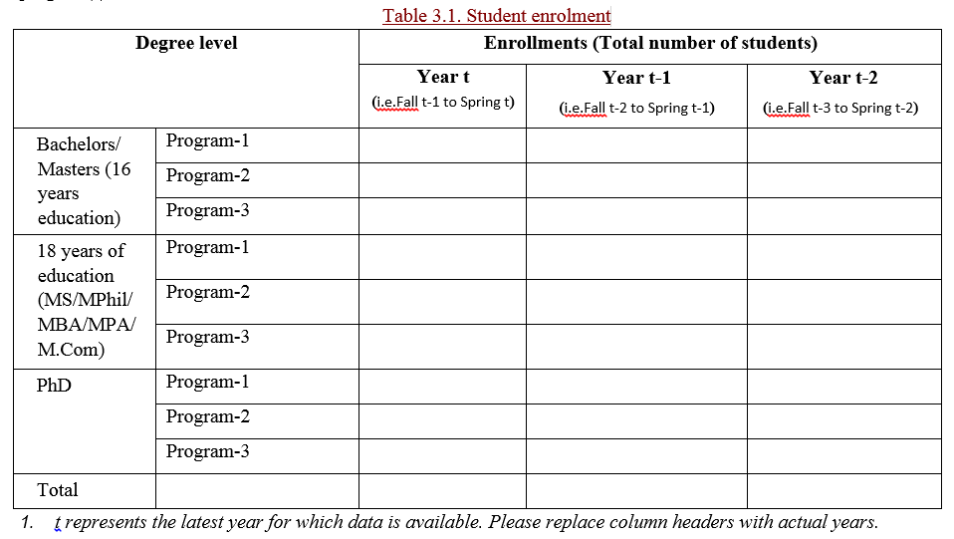

Slide 40
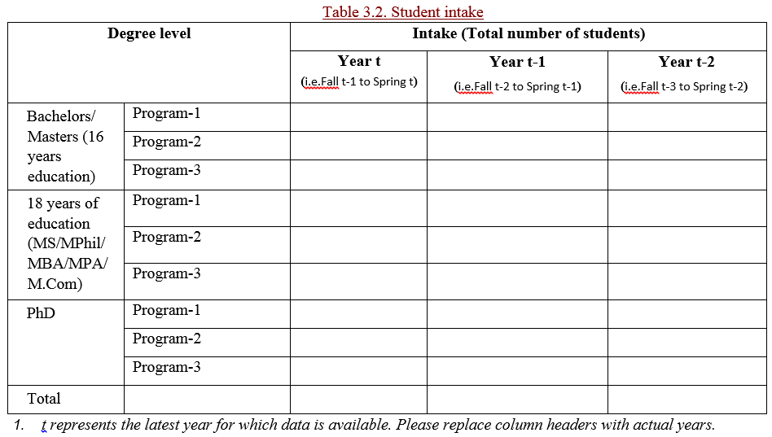

Slide 41
Success percentage
Success percentage is to be calculated for the last three batches that have graduated.
[{Registered students + Graduated students (same batch)}/admitted students]x100 (same batch).

Slide 42
Drop out percentage
Drop out percentage is to be calculated for academic reason
(Total number of students of the batch who have left because of academic warnings/Total number of students admitted in that batch) x 100

Slide 43
Example for success percentage and drop out percentage
At the time of graduation of batch X, 45 students are graduating- they are graduated students. However, 15 students of batch X will not graduate with their batch as they have a few courses remaining - these are the registered students. However, at the time of admission, two or four years ago for masters or bachelor’s degree program respectively, 70 students were admitted in batch X - these are the admitted students. 10 students (70-45-15) have left over the time period of the degree for various reasons and are neither graduating, nor registered i.e. they have dropped out. Out of these 10 students 08 have left for academic reason and 02 students transferred to other universities. Thus,
Success percentage for batch X= [{15+45}/70]x100=85.71%
Drop out percentage for academic reason for batch X= (8/70) x100=11.43%

Slide 44
Appendices for P3
Name | Description
Appendix-3A | Policy and process of scholarships disbursement
Appendix-3B | Calendar of activities and the initiatives taken to develop and grow the student body beyond classroom teaching for the current and the last three semesters
Appendix-3C | Any relevant document to evaluate the effectiveness of assistance provided to students who experience difficulties or problems e.g. through counselors for weak students, remedial actions, extra tuitions
Appendix-3D | Student counseling and guidance policy
Appendix-3E | Policy to encourage students to participate in any extra-curricular activities and co-curricular activities
Appendix-3F | List of participation of the business school’s students in extra-curricular and co-curricular activities over the last three years.
Appendix-3G | Calendar of extra-curricular activities of the business school for the last three years.
Appendix-3H | Calendar of co-curricular activities of the business school for the last three years.
Appendix-3I | Structure and by-laws alumni association/ chapter/ cell in the business school
Appendix-3J | Policy documents and/or SOPs to maintain updated records of alumni and their employment status

Slide 45
Supporting Document for P3
Blank student feedback form (course feedback and/or faculty feedback)
Student handbook (Student code of moral ethics and principles)
Evidence of activities performed by student clubs/societies
Students’ internship/ project reports (last three years; random sample will be requested during the visit)
Alumni details (last two years; separately mention entrepreneurs)
List of batch advisors or student councilors
List of student scholarships, including details of distribution of need and merit base scholarships
Evidence of extracurricular activities
Evidence of placement activities
Evidence of alumni activities
List of students who have dropped out over the last three years(along with reasons, if available)
Evidence of announcements of scholarships

Slide 46
Expected Standards in Students
Discussion on standards document

Slide 47
Questions?

Slide 48
Session 4
9:00 am -11:00 am
Discussion on SAR forms (4-7)
 | NATIONAL BUSINESS EDUCATION ACCREDITATION COUNCIL www.nbeac.org.pk

Slide 49
Proforma 4: Faculty
A critical mass of permanent faculty is required to ensure the continuity of the School, embodiment of its tradition and values, and development of its distinctive expertise through research and program innovation.

Slide 50
Proforma 4: Faculty
Effective faculty management is a crucial function within management education institutions. There should be processes in place for the recruitment, deployment, evaluation and development of the faculty. Workload should allow a reasonable balance between teaching, research, new program development, and internal managerial responsibilities.

Slide 51
Accreditation Criteria
Faculty Size and Portfolio
Faculty Qualifications
Faculty Planning
Faculty’s stability and turnover
Faculty to Student Ratios
Faculty Policies: Recruitment and Selection
Faculty Promotion, Retention and Development
Faculty Evaluation and Assessment
Role of Faculty in Decision Making
Faculty Consulting and Training Engagements
Faculty Engagements in the Social and Professional Organizations, and Businesses
International exposure of the faculty

Slide 52
Key Definitions
Core Business Faculty
Permanent / Regular Faculty
Visiting Faculty
Adjunct Faculty
Core Faculty with Foreign Experience
Non-national Faculty

Slide 53
Key Formulae
FTE= ∑(No. of courses taught by permanent/regular faculty in the program/course load per semester)
Adjunct FTE= ∑(No. of courses taught by adjunct faculty in the program/course load per semester)
Visiting FTE= ∑(No. of courses taught by visiting faculty in the program/course load per semester)
Faculty-to-student ratio (for a program)
(Total number of students enrolled in the degree program/
[Permanent FTE+ Adjunct FTE + (Visiting FTE/3)]).

Slide 54
Points to Ponder
Why is diversity in faculty portfolio a concern for NBEAC?
Workload and why it matters
Inclusion of faculty in strategic and operation processes – need and significance
Faculty involvement in training / consultancy / community service/ institutional matters and what it signifies
The focus on faculty related (HR) policies – significance and influence on stability

Slide 55
Main Points Covered in P4
Significance of faculty in the quality assurance process
Key definitions
Key Formulae
Faculty portfolio – diversity and mix
Faculty workload
Ratios
Faculty Policies

Slide 56
Appendices for P4
Name | Description
Appendix-4A | Policy of faculty planning
Appendix-4B | Faculty selection and hiring policy
Appendix-4C | Faculty retention and promotion policy
Appendix-4D | Faculty annual evaluation and assessment policy
Appendix-4E | Faculty consultancy and training policy
Appendix-4F | Policy to increase faculty exposure to the corporate world and to social organizations
Appendix-4G | Policy of increasing international exposure of faculty

Slide 57
Supporting Documents for P4
Minutes of last three meetings of the Selection Board
List of updated faculty (in case there are any changes since SAR submission)
A folder of CVs of all faculty members listed in Table 4.2.
A folder of CVs of all visiting and adjunct faculty named in Table 4.5.
Faculty Handbook
A copy of blank performance appraisal form (few completed forms may be requested during the visit)
Grade Plan- Pay Structure
Question Papers (Midterms and finals of last two semesters; a few samples may be requested during the visit)
A list of guest speakers of the last three years (if any)
Job descriptions of course coordinators (if any)
Job description of batch advisors (if any)
Evidence of penalty of cheating and plagiarism cases

Slide 58
Expected Standards in Faculty
Discussion on standard document

Slide 59
Proforma 5: R&D
The School should consistently produce original and applied contributions to knowledge and disseminate them effectively. The research and development contributions should make an impact on strategically important constituencies including academic peers, management professionals, students, national development and society.

Slide 60
R&D Proforma Introduction
NBEAC defines “research” as a broad spectrum of intellectual undertaking. It ranges from scholarly publication primarily directed towards the academic community, to professionally relevant publications and activities targeting organizations and business practitioners, to educationally relevant productions for learners and teachers in the universities, schools and companies. Therefore, within the NBEAC criteria, the term has broad meaning and goes beyond purely academic concept of research.

Slide 61
Accreditation Criteria P5
R&D Policy
Sufficiency of Time Devoted to Research
Adequacy of Funding for Research
Quality of the Research Output
Distinctive Expertise
Innovative Development
Contribution of R&D to Courses and Programs
Contribution of R&D to Faculty Development
Contribution of Consultancy to Faculty Development

Slide 62
Main Points Covered in P5
Self-standing research centers or institutes
Research policy and research strategy
Dean/Director of research, scientific committee?
Academic journal?
R&D funding and breakdown
Publications summary (3 years) and APA style end-text referencing
Contribution of research to learning and program innovation
R&D spending on faculty development
Sharing of knowledge from consultancy projects

Slide 63
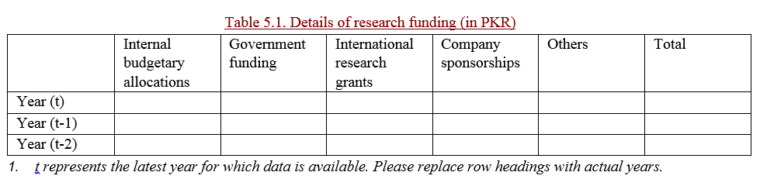
Research Funding
Funding greater than PKR 100,000
  name of the project
  name of the principal investigator
  name of funding agency
  amount of funding
  completion stage of the project
  a 100-200 words summary

Slide 64
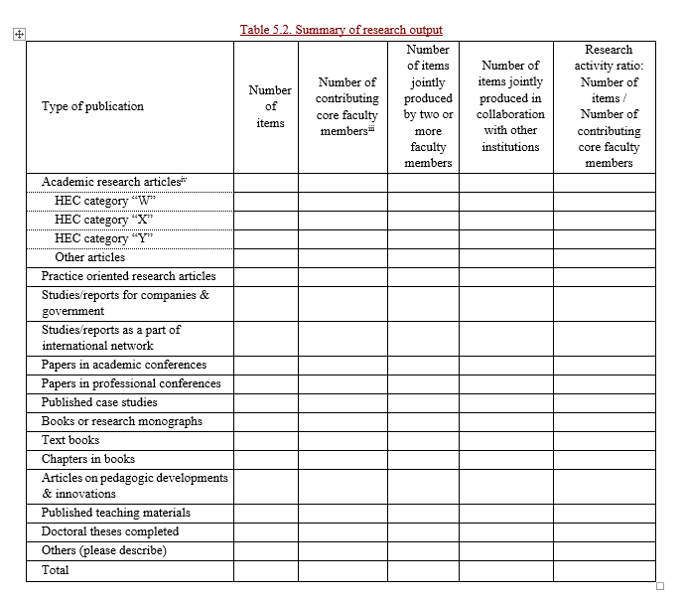

Slide 65
Important Note for Research Output
Report data on research and publication for the core faculty, defined as members of the faculty for whom the school is the principal employer. The report should not include publications of part-time staff from other schools or departments, adjunct faculty,
visiting professors, or business practitioners.

Slide 66
Appendices for P5
Name | Description
Appendix-5A | R&D policy
Appendix-5B | Aim/scope, submission guidelines and volumes per years of the business journal
Appendix-5C | List the name of the project, the name of the principal investigator, the name of funding agency, amount of funding and completion stage of the project
Appendix-5D | Attach a complete list of items mentioned in Table.5.2 using APA end-text referencing. For each academic research article, clearly mention the impact factor and/or HEC category at the end of the reference.

Slide 67
Supporting Document for P5
Minutes of the last three meeting minutes of Board of Advanced Studies and Research
Copies of the schools management or business journals for the last three years (if applicable)
Copy of any publication of the faculty (a few random publications to be provided upon request)
Details of R&D budget and expenses
Details of travel grants availed by the faculty over the last three years

Slide 68
Expected Standards in R&D
Discussion on standards document

Slide 69
Proforma 6: Social Responsibility
The School should have a clear understanding of its role as a ‘globally responsible entity’ and its contribution to ethics and sustainability. This understanding should be reflected in the School’s strategy and activities. There should be evidence that the School’s contribution is reflected in its regular activities, covering education, research, interactions with businesses and managers, community outreach and its own operations.

Slide 70
Accreditation Criteria P6
Policy of Community Services and Social Activities
Formal Relationships with Social Sector Organizations
Code of Moral Principles, Ethics, Behaviors and Conducts
Development and Protection of Internal Community
Impact on the Society

Slide 71
Main Points Covered in P6
Policy and/or guidelines for social responsibility
Projects and activities over the last three years
List of MoUs
Code of ethics and moral principles and its communication
  For students
  For faculty and staff
  Values of the school
  Environmental protection and sustainability
Policies for protection of internal community and their communication
  Health and safety
  Anti-harassment policy
  Loan schemes, welfare funds
  Others
Impact assessment of social initiatives
(Evidence of implementation during the visit)

Slide 72
Appendices for P6
Name | Description
Appendix-6A | School’s policy and/or guidelines of community services and social activities
Appendix-6B | School’s code of moral principles and ethics
Appendix-6C | Policy documents which relate to improving the quality of working life of the internal community including health and safety policy, anti-sexual harassment policy, loan schemes, welfare funds.

Slide 73
Supporting Document for P6
Evidence of activities of various student clubs/societies listed in Table 6.1
Evidence of activities listed in Table 6.2
Copy of all MoUs listed in Table 6.3
Documentary evidence of the activities carried out under the MoU listed in Table 6.3
File of cases/complaints relating to code of moral principles and ethics
File of cases/complaints relating to any item covered under Q-7 of Proformae -06
Financial evidence of any initiatives taken to improve the quality of life of internal community

Slide 74
Expected Standards in Social Responsibility
Discussion on standards document

Slide 75
Proforma 7: Resources
The School should demonstrate financial viability and institutional continuity, with physical resources and facilities to provide a high quality learning environment with sufficient high quality administrative staff and processes to support the School’s range of activities.

Slide 76
Accreditation Criteria
Financial Management System
Learning Environment
Library and Computing Facilities
Other facilities
Administrative Support Function
Quality Enhancement Cell
Notes:
(This is a C/P from the rubric. SANIA will have these lists in X category document)

Slide 77
Main Points Covered in P7
Adequacy of resources – criticality and necessity
Financial planning, need for establishing trend and financial autonomy
Financial risks and strategy for mitigating it
Administrative staff – significance, number and function
Infrastructure – Development of a conducive student-faculty learning environment
Quality Enhancement Cell and its functions

Slide 78
Supporting Documents for P7
Budget and Accounts (Audited) for the last three years
The quality audit reports prepared by QEC for the school over the last three year

Slide 79
Expected Standards in Resources
Discussion on standard document

Slide 80
Questions?

Slide 81
Session 5
11.30 am -12.30 pm
Discussion on SAR forms (8-9)
 | NATIONAL BUSINESS EDUCATION ACCREDITATION COUNCIL www.nbeac.org.pk

Slide 82
Proforma 8: External Linkages & Student Placement
NBEAC stresses on the need to establish and provide evidence of link with external organizations (academic, corporate, welfare) both at the national and international level. This standard has at its core the aim to encourage School’s to optimize benefits for its’ students and faculty, by establishing links with the industry and academia.

Slide 83
Accreditation Criteria
International Linkages
National Linkages
Corporate Linkages and Relations
Participation in Academic Governance
Student and Faculty Exchange Programs
Placement Office: Internships and Placements
Placement office: Corporate Involvement
Notes:
(This is a C/P from the rubric. SANIA will have these lists in X category document)

Slide 84
Main Points Covered in P8
National / international linkages – policies, processes and nature of involvement
Affiliations, MoUs and MoAs
Student – Faculty Exchange Programs
Placement Office – Structure, policies and functions
Key employers

Slide 85
Appendices for P8
Name | Description
Appendix-8A | Policy of international linkages
Appendix-8B | Policy of national linkages
Appendix-8C | Policy of corporate linkages
Appendix-8D | Policy of student and faculty exchange programs
Appendix-8E | List of MoUs for student and/or faculty exchange
Appendix-8F | Profiles of the staff working in the placement office/center
Appendix-8G | Policy of management of internships and placements
Appendix-8H | Calendar of activities carried out by the placement office over the last three years and the calendar of activities for the current semester

Slide 86
Expected Standards in External Linkages & Student Placement
Discussion on standard document

Slide 87
Proforma 9: Admissions & Examination Policy
Quality in the admissions and examination processes positively reflect in the quality of graduates of a School. Sanctity in these processes provides evidence of systemic transparency, merit and integrity.

Slide 88
Accreditation Criteria
Admissions Office
Student Selection Processes
Examination Monitoring
Examination Cell
Notes:
(This is a C/P from the rubric. SANIA will have these lists in X category document)

Slide 89
Main Points Covered in P9
Admissions Office – structure, manpower, processes and policies
Examination Office – structure, manpower, processes and policies
Student intake – policy, frequency, eligibility criteria and selection criteria
Migration / transfer policy
Continuous improvement

Slide 90
Appendices for P9
Name | Description
Appendix-9A | Profiles of the staff working in the admission office
Appendix-9B | Admission policy
Appendix-9C | Semester/academic calendar for last three years
Appendix-9D | Credit transfer and the credit exemption policy
Appendix-9E | Migration/student transfer policy
Appendix-9F | Documentary evidence to support that the examination rules implemented continuously over the last three years

Slide 91
Supporting Documents for P9
Written details about the fee structure
Two samples of the entry exams
Merit lists of the last three years
Records of students’ admission process including marks and lists of accepted and rejected candidates
Gazette Results

Slide 92
Expected Standards in Admissions & Examination Policy
Discussion on standard document

Slide 93
Session 6
1.30 pm - 3.15 pm
Discussion on preparation and conduct of PRT
 | NATIONAL BUSINESS EDUCATION ACCREDITATION COUNCIL www.nbeac.org.pk

Slide 94
A Few Questions
How many of you have experienced an NBEAC visit?
Lets make it a pleasant and fruitful experience for the university and for the team.

Slide 95
Three Day Visit
(Note: Proformas are not in order)
Dinner of PRT on Day 1
Strategic level meeting, including VC
A presentation and often a discussion of proformas of SM and Resources
A tour of the school
Remaining parts of SM and Resources proformas
Proforma discussion: Admissions and examination policy
Proforma discussion: Curriculum
Proforma discussion: Linkages and social responsibility
Alumni dinner
Faculty form
Students form
Meetings with students and faculty
Classroom visit
R&D form (or Day 1, if time)
Verbal feedback to the VC, top team and senior faculty

Slide 96
Arrangements for PRT
A large, comfortable room for the 2.5 days on the campus
Availability of all listed documents (sent in advance) in the room prior to arrival (a very few confidential documents may be brought to the room after the arrival, but please inform the chair person of this upon arrival)
Arrange the documents in the room per Proforma
If there has been major changes in any appendices, please make a list of these appendices and formally hand over the list of documents to the chair person
Invite the appropriate individuals during each session
Provide any additional documents requested during the visit
The PRT has the right to assume that any documents which have not been provided do not exist

Slide 97
Arrangements for PRT contd…
Please provide safe and comfortable pick and drop from the pick up point to the university
Please provide safe and comfortable accommodation (Wi-Fi availability)
Please provide a printer on the last day
Avoid gifts; if souvenirs are provided, they must be within the limit suggested by NBEAC
Please keep the working lunches light and simple
Day 0 and Day 2 dinners are for PRT members only, as this is time for internal meetings and discussions

Slide 98
Prepare well
to make it a pleasant experience
for everyone involved
Lets continue to learn from each other

Slide 99
NBEAC Training
Understanding and Preparing for Accreditation
24-25 July, 2017
Dr. Sadia Nadeem, FAST School of Management, NUCES, Islamabad | Dr. Asfia Obaid, NUST Business School, NUST, Islamabad

